Slide 1
Dynamic Test-Time Compute Allocation for LLM Reasoning
RESEARCH PROPOSAL
Data Science Team

Slide 2
Orange
Innovation
EXECUTIVE SUMMARY
The case for adaptive compute
PROBLEM. Reasoning LLMs gain accuracy from more test-time compute, but most deployments apply a single fixed budget to every input.
  Underthinking hard problems and overthinking easy ones, sometimes with flat or negative returns
  Includes correct-to-incorrect “flips” — cases where extra compute actively hurts accuracy
CURRENT SOLUTIONS. Two families of dynamic allocation methods exist:
Reactive — decide during generation, by monitoring a signal such as confidence or entropy and stopping once a threshold is crossed (e.g., entropy-triggered stopping, DEER).
Predictive — decide before generation, by reading a difficulty signal from the model or query and choosing a strategy up front (e.g., DiffAdapt’s hidden-state probe, learned routers).
Why it’s suboptimal. Each family has its own limitations:
Reactive — methods are trained or calibrated per model, several operate at coarse granularity, and cross-model generalization of the predictor itself is untested.
Predictive — methods rely on signals — confidence, entropy — that can be false positives (a model can be confidently wrong), and their thresholds are hand-tuned per model and temperature rather than transferring.
No study has compared a reactive and a predictive method head-to-head under one shared protocol that jointly reports accuracy, compute, and interpretability.
Dynamic Test-Time Compute Allocation
02

Slide 3
Orange
Innovation
EXECUTIVE SUMMARY
Core hypothesis & contribution
CORE HYPOTHESIS. Allocation of compute can be improved through two complementary directions:
Reactive — refining the signal used to detect when reasoning has actually converged — moving beyond surface-level confidence or entropy toward an internal, model-derived indicator that more accurately determines when thinking should stop.
Predictive — required compute may be predictable from task difficulty beyond a difficulty-only baseline. The open question is whether this relationship holds generally or only in specific settings.
POSSIBLE CONTRIBUTION.
Hypothesis validation — test our hypotheses empirically and determine whether the proposed assumptions hold.
Direction selection — based on the test results, determine which approach to pursue further; the final direction will be determined later according to the findings.
Fixed Budget vs. Adaptive Budget
FIXED BUDGET — SAME REASONING BUDGET FOR EVERY INPUT
PROPOSED — BUDGET MATCHED TO DIFFICULTY
Easy problem
Easy problem
optimal
overthinks — wasted tokens, flat/negative return
stops once accuracy saturates
Hard problem
Hard problem
optimal
underthinks — abandons promising reasoning
spends compute where it pays off
Dynamic Test-Time Compute Allocation
03

Slide 4
Orange
Innovation
1. BACKGROUND & RESEARCH GAP
Two documented failure modes — not yet reconciled
The two failure modes. Test-time scaling improves accuracy by allocating more inference compute through longer reasoning, sampling, or search. However, fixed budgets for all inputs can lead to two opposite failure modes.
Underthinking — Wang et al., “Thoughts Are All Over the Place” (NeurIPS 2025): can arise from two distinct compute-allocation failures: the model may either receive too little compute for the problem, or have sufficient compute but allocate it inefficiently.
Insufficient Compute
Evidence: on hard problems, incorrect responses may stop before reaching a reliable solution because the allocated budget is insufficient.
Research direction: identify queries that require more reasoning and allocate additional compute rather than using a fixed budget.
Inefficient Compute — partially out of scope
Evidence: incorrect responses show far more thought switches despite often being longer: QwQ-32B-Preview 26.4 vs. 7.0 and DeepSeek-R1-671B 59.3 vs. 12.6 switches on AIME2024. This suggests compute is being spent restarting thoughts rather than reasoning deeper.
Research direction: refine the convergence signal to distinguish genuine reasoning progress from inefficient thought switching and decide when to continue or stop.
Dynamic Test-Time Compute Allocation
04

Slide 5
Orange
Innovation
1. BACKGROUND & RESEARCH GAP
Two documented failure modes — not yet reconciled
Overthinking can also arise from two distinct compute-allocation failures: the model may either spend unnecessary compute on easy problems, or allocate compute inefficiently across different domains.
Unnecessary Compute
Evidence: DiffAdapt finds a U-shaped entropy–difficulty relationship: entropy is high on easy problems despite high accuracy, drops by 22–25% at medium difficulty, then rises again on hard problems. This suggests that easy-problem entropy reflects wasted exploration rather than genuine uncertainty.
Research direction: identify easy queries and allocate less compute instead of applying a fixed budget.
Domain-Mismatched Compute
Evidence: Yang et al. show that increasing CoT length has domain-dependent returns: it helps some problem sets but can harm others, and the optimal length distribution differs by domain rather than depending only on difficulty.
Research direction: refine the allocation signal to account for domain-specific reasoning behavior rather than relying solely on a difficulty-based estimate.
Open question: the literature does not disagree on whether overthinking exists — DiffAdapt, TOPS, and Sui et al. all document it. What is unresolved is whether it is a true inverted-U (net accuracy loss) or pure saturation (flat accuracy, wasted compute only), and whether this differs by task type. This proposal treats net accuracy loss from overthinking as an open empirical question, verified per model/benchmark rather than assumed.
Dynamic Test-Time Compute Allocation
05

Slide 6
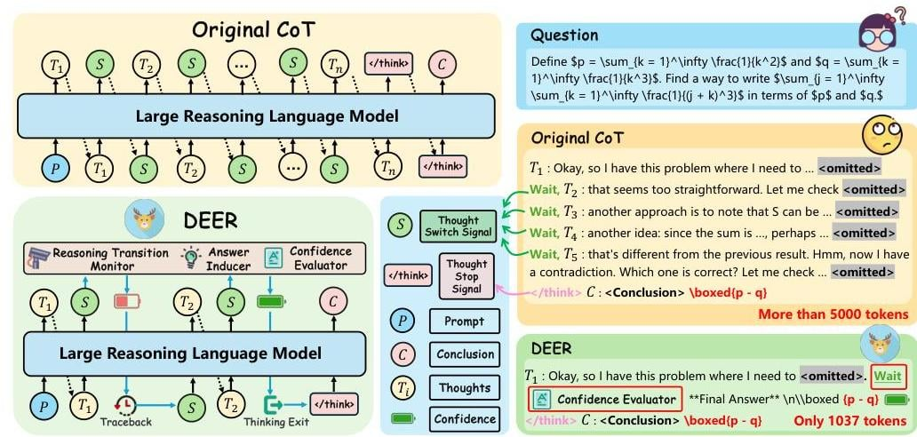
Orange
Innovation
2. CURRENT SOLUTIONS
2.1 Reactive — Confidence/Entropy Early Exit (DEER)
2.1 REACTIVE METHODS (decide during generation)
Confidence / Entropy-Based Early Exit.
(Yang et al., “Dynamic Early Exit in Reasoning Models,” 2025 — DEER; general confidence/entropy early-exit class)
Mechanism: monitor a per-step scalar token entropy as a signal, self-consistency across sampled continuations, or logit-derived confidence — and stop once it crosses a threshold. DEER specifically detects “reasoning transition points” (e.g., the token “Wait”), injects a forced trial-answer prompt at that point, and reads the model’s confidence in that trial answer; if confidence is high, it stops, otherwise it discards the trial and continues.
Reported results: DEER achieves 19–80% CoT length reduction with +0.3–5.0% accuracy across 11 models and 10 benchmarks.
Limitations:
  False positives: the signal can be misleading — a model may be highly confident while still being wrong, especially after RLHF/RLVR where confidence and correctness can become decoupled.
  Poor transferability: thresholds are typically hand-tuned for each model and temperature, limiting their ability to generalize across settings.
  Blind spot: DEER only stops when confidence is high; it cannot identify queries that remain uncertain and are likely to be wrong.
Dynamic Test-Time Compute Allocation
06

Slide 7
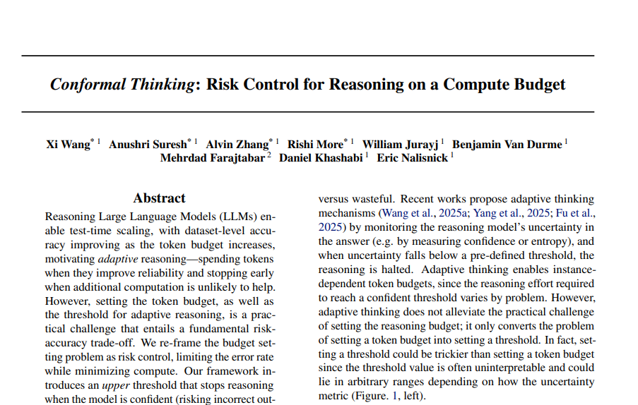
Orange
Innovation
2. CURRENT SOLUTIONS
2.1 Reactive — Conformal / Risk-Controlled Stopping
2.1 REACTIVE METHODS (decide during generation)
Conformal / Risk-Controlled Stopping. (Conformal Thinking, Apple, 2026; Thought Calibration, 2025)
Mechanism: reframe budget-setting as distribution-free risk control (Learn-Then-Test): given a target error rate α and a calibration set, derive a stopping threshold with a finite-sample statistical guarantee that stopping error stays below α. Conformal Thinking adds a second, lower threshold that pre-emptively halts instances flagged as likely-unsolvable, directly addressing the blind spot in confidence-only early exit.
Limitations:
  Calibration required: requires a held-out calibration set for each model/task pair.
  Marginal guarantee: the guarantee holds on average over the calibration distribution, not for each individual instance.
  Monotonicity assumption: assumes the risk function is monotonic with respect to the threshold, which is only reliably verifiable in the large-sample regime.
Our use of this method: it can serve directly as the statistical-validation layer for any adaptive method this proposal produces.
Dynamic Test-Time Compute Allocation
07

Slide 8
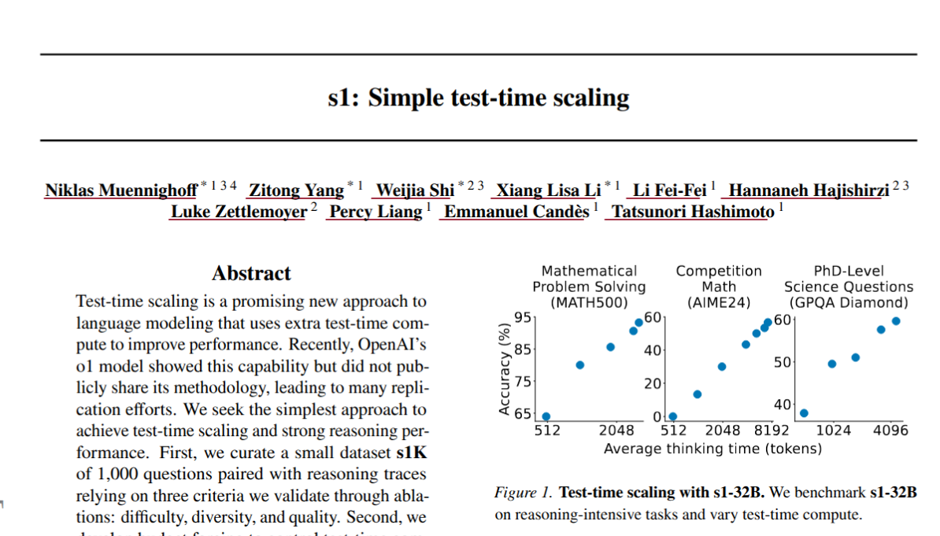
Orange
Innovation
2. CURRENT SOLUTIONS
2.2 Predictive — Budget Forcing (s1)
2.2 PREDICTIVE METHODS (decide before generation)
Budget Forcing. (Muennighoff et al., “s1: Simple Test-Time Scaling,” EMNLP 2025)
Mechanism: a fixed, global token cap; if the model tries to stop early, suppress the end-of-thinking token and append “Wait” to force continuation; if it exceeds the cap, force termination.
Limitation: the cap is a single hand-set number for all inputs — it is control, not adaptation; later work (L1) shows this crude intervention degrades performance relative to a length-conditioned policy.
Our use of this method: it serves as the right lower-bound ablation baseline — any adaptive method here must beat naive budget forcing at matched average token count.
Dynamic Test-Time Compute Allocation
08

Slide 9
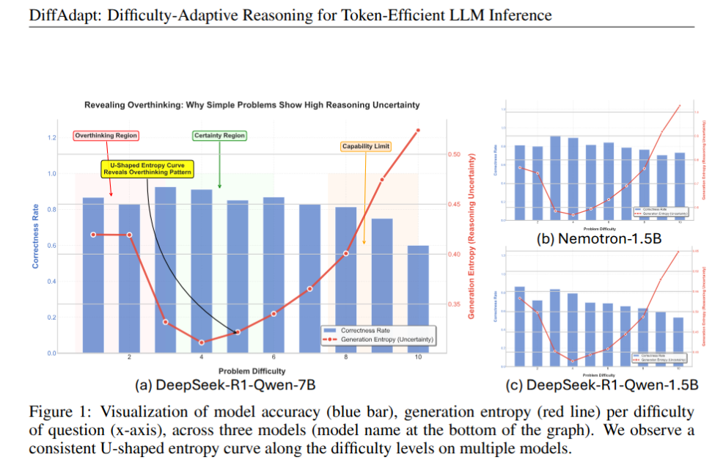
Orange
Innovation
2. CURRENT SOLUTIONS
2.2 Predictive — DiffAdapt
2.2 PREDICTIVE METHODS (decide before generation)
DiffAdapt. (Liu, Hu, Chu & Choi, “DiffAdapt: Difficulty-Adaptive Reasoning for Token-Efficient LLM Inference,” 2025)
Mechanism: a three-stage framework — (1) sample a proxy model’s responses to heuristically label each training query Easy/Normal/Hard from observed entropy and correctness; (2) train a lightweight probe on the base model’s final hidden state to predict that label; (3) at inference, the probe selects one of three fixed (prompt, temperature, max-length) configurations. No base-model fine-tuning.
Reported results: up to 22.4% token reduction with comparable or improved accuracy, across 5 models and 8 benchmarks.
Limitation:
  only three discrete strategies (coarse granularity, not a continuous budget);
  the probe is trained per base model, since hidden-state geometry is model-specific.
Dynamic Test-Time Compute Allocation
09

Slide 10
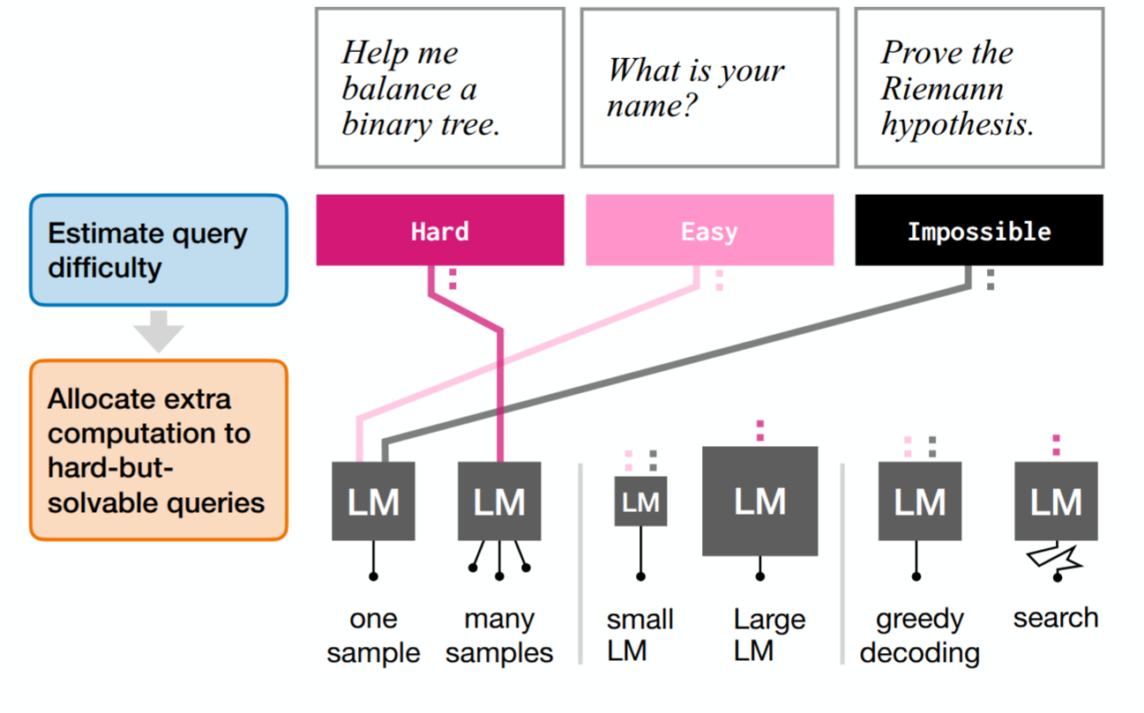
Orange
Innovation
2. CURRENT SOLUTIONS
2.2 Predictive — Learned Routers
2.2 PREDICTIVE METHODS (decide before generation)
Learned Routers. (Damani, Shenfeld, Peng, Bobu, and Andreas, “Learning How Hard to Think: Input-Adaptive Allocation of LM Computation,” ICLR 2025)
Mechanism: trains a marginal reward predictor — the expected accuracy gain from allocating one more unit of compute (e.g., one more best-of-N sample) to a given query — and allocates compute where the predicted marginal value is highest.
Limitation: the predictor is trained per model/task, cross-model transfer is not reported, and the best-of-N framing does not directly cover single-chain CoT length control.
Our use of this method: reuse the marginal-value framing — “allocate compute where its predicted value is highest” — as the guiding principle for a compute-allocation equation grounded in prior work rather than assumed from scratch.
Dynamic Test-Time Compute Allocation
10

Slide 11
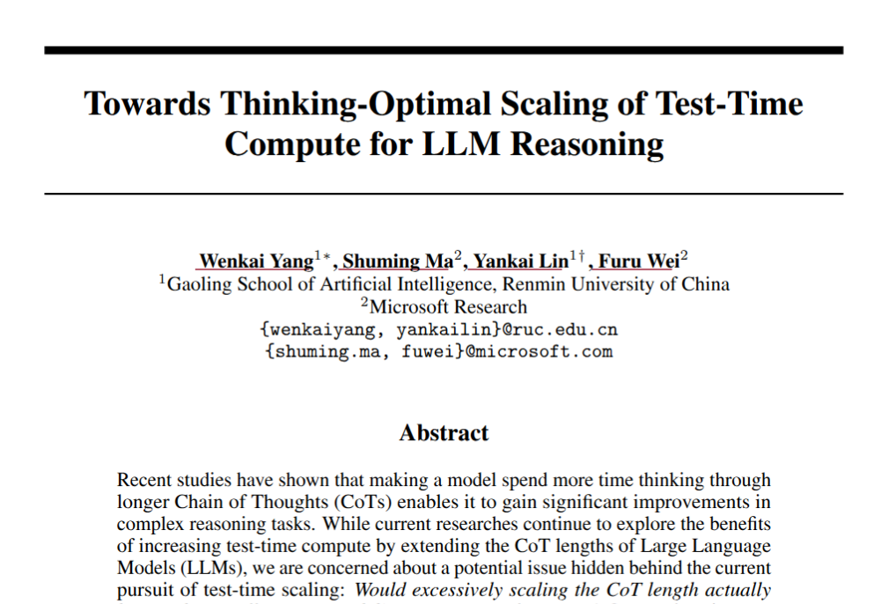
Orange
Innovation
2. CURRENT SOLUTIONS
2.2 Predictive — Thinking-Optimal Scaling (TOPS)
2.2 PREDICTIVE METHODS (decide before generation)
Thinking-Optimal Scaling (TOPS). (Yang et al., “Towards Thinking-Optimal Scaling of Test-Time Compute for LLM Reasoning,” NeurIPS 2025)
Mechanism: supervised fine-tuning on a small seed set spanning several reasoning-effort levels (“format imitation”), then self-improvement by sampling multiple efforts per training query and keeping the shortest correct response as the preferred target — baking a domain-conditioned length policy into the weights.
Limitation: granularity is domain-level, not instance-level — a domain gets one length distribution, not each query its own budget — and building the training set requires generating multiple full responses per example.
Our use of this method: TOPS’s finding that the optimal length distribution differs by domain is direct prior evidence for a task-type hypothesis, and an instance-level predictor can be tested against TOPS’s domain-level one at matched compute.
Dynamic Test-Time Compute Allocation
11

Slide 12
Orange
Innovation
2. CURRENT SOLUTIONS
Summary — gap in one table
Method
Compute control
Per-model training?
Key limitation
DEER
Confidence-threshold triggered
Threshold tuned
Threshold tuning; calibration-sensitive
Conformal Thinking
Trained length-conditioning
Calibration set
Needs calibration data; marginal guarantee
Budget Forcing (s1)
Confidence-threshold triggered
NO (fixed cap)
Fixed
DiffAdapt (difficulty classifier)
Reactive, per-step
Probe per model
Per-model classifier training required, discrete
Learned Routers
Predictive, trained
Per model/task
Untested generalization
TOPS
Predictive, difficulty-driven
SFT per model
Coarse granularity (domain, not instance)
Conclusion: existing methods address different aspects of adaptive compute allocation, but none simultaneously provides instance-level allocation, cross-model generalization, and statistical calibration. This work targets their intersection and evaluates it under a unified experimental protocol.
Dynamic Test-Time Compute Allocation
12

Slide 13
Orange
Innovation
3. METHODOLOGY
A. Investigation — four falsifiable hypotheses
Building in stages — each hypothesis widens the scope of the previous, from a single model/task up to the central predictive claim.
H1. poor test-time compute allocation harms performance — underthinking on hard problems, overthinking on easy ones. Tested via statistically controlled compute–accuracy curves (≥5 samples per compute level), checking for saturation or an inverted-U pattern.
H2. this holds across model families rather than being model-specific. Tested for whether curve shape — saturating, inverted-U, or monotonic — is consistent across at least three model families.
H3. this varies by task type — open-ended generation (proof writing, code synthesis) vs. selection among a fixed set of options (multiple-choice, verification): does the generation-vs-selection distinction, not just difficulty, shape the optimal budget curve?
H4. a difficulty-only baseline explains only part of the variance in the compute a query actually needs — measuring the residual variance that remains sets the bar the next hypothesis must clear.
Reactive
H1
H2
H3
H4
Development
Predictive
To be determined based on the findings
Dynamic Test-Time Compute Allocation
13

Slide 14
Orange
Innovation
3. METHODOLOGY
B. Development — the proposed allocation pipeline
Each question flows through the pipeline in order; the RL residual stage only changes the outcome for cases flagged as hard to judge.
Long-tail /
misjudged
case?
Final
Compute
Budget
Input
Theoretical
Estimate
Predictive
Correction
→
→
→
no
Question + model params
C₀ = f(difficulty, params)
— closed form
ΔC = g(C₀, features)
learned residual
yes
RL Residual Correction
Overrides C₀ + ΔC for this case only
Example: difficulty 0.72, 70B model — theoretical estimate ≈ 1,200 tokens → predictive correction +150 → flagged long-tail → RL override to 1,600 tokens, traceable at every step.
Dynamic Test-Time Compute Allocation
14

Slide 15
Orange
Innovation
3. METHODOLOGY
B. Detail — Stage 0 & 1
Stage 0 — cheap difficulty signal extraction
  Before any budget estimate, run a short, fixed-cost probe on the query; this avoids the chicken-and-egg problem of needing to know how hard a question is before deciding how long to think about it.
  Option A — short forced-CoT prefix (64–128 tokens) whose token-probability entropy trajectory is read out as the signal.
  Option B — base model’s final hidden state after reading the question only — no generation yet — fed to a small trained classifier.
  Both cost a small fixed number of extra tokens, and produce a cheap difficulty proxy d̂ that we can learn to trust empirically rather than assuming a priori.
Stage 1 — calibrated theoretical baseline
  Scaling-law fit C₀ = A·d̂^β + C_min, calibrated on a modest set of ≥some dozens of examples per model; only three free parameters per model family, so it stays interpretable and needs little calibration data.
  Grounded in compute-optimal scaling curves and the marginal-value principle rather than assumed from scratch.
Dynamic Test-Time Compute Allocation
15

Slide 16
Orange
Innovation
3. METHODOLOGY
B. Detail — Stage 2 & 3
Stage 2 — predictive correction
  ΔC = g(C₀, x), x = {entropy trajectory, hidden-state probe output, optionally one short self-consistency sample}.
  g is a lightweight regression trained on the residual between C₀ and the empirically optimal compute for each example — it only learns the correction on top of Stage 1’s starting point.
  Compared directly against DiffAdapt’s probe and Damani’s marginal-value predictor (all occupy the same predictive slot).
Stage 3 — reactive exception layer with a statistical guarantee
  Stages 0–2 fix a budget before generation; Stage 3 watches generation for the subset of queries where that pre-set budget is likely to be wrong — the long tail of unusual cases the predictive stages miss.
  The reactive signal is investigated under the H1 investigation and tested, not assumed; evaluated on calibration (ECE) and stopping accuracy vs confidence/entropy baselines.
  Calibrated, not hand-tuned: Learn-Then-Test conformal risk control derives an upper threshold (stop when confident) and a lower threshold (pre-emptively stop likely-unsolvable), with a finite-sample guarantee that stopping error stays below α. Overrides C₀ + ΔC only for flagged long-tail cases.
Dynamic Test-Time Compute Allocation
16

Slide 17
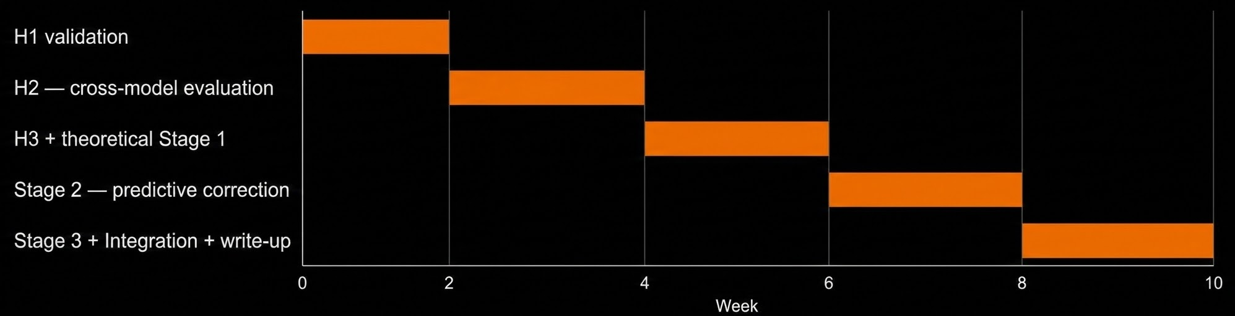
Orange
Innovation
4. TIMELINE
10-week research plan
Week 1&2 — single-model, compute–performance curves; confirm under/overthinking exists and analyse patterns.
Week 3&4 — second stage, extends H1 to more models, sizes, and examples.
Week 5&6 — theory stage; derive the predictive compute allocation equation from empirical data.
Week 7&8 — train and evaluate the predictive correction layer against the theoretical estimate.
Week 9&10 — reactive layer and final integration, write-up, and defense prep.
Dynamic Test-Time Compute Allocation
17

Slide 18
Orange
Innovation
H1 — TESTING
Dynamic Test-Time Compute Allocation
18

Slide 19
Orange
Innovation
H1 — TESTING METHODOLOGY
H1 — Hypothesis & motivation
Hypothesis. poor test-time compute allocation harms performance — underthinking on hard problems, overthinking on easy ones — tested via statistically controlled compute–accuracy curves (≥5 samples per compute level), checking for saturation or an inverted-U pattern.
Motivation — simulating everyday use. the goal of this testing phase is to simulate realistic, everyday LLM usage — a mixture of task types (code, math, general questions, multichoice), at varying difficulty levels, from several benchmarks — so the results are not biased toward any single task type.
The problem — Simpson’s paradox. simply pooling raw accuracy across benchmarks can produce a misleading single curve. Benchmark task types may individually improve monotonically with compute, saturate, or degrade, giving different curve types that can cancel out when averaged together — masking the exact under/overthinking effect H1 must establish or rule out.
  generation-type tasks vs selection-type tasks vs computation-heavy tasks may all behave differently: per-curve type analysis is required before any aggregate conclusion.
Dynamic Test-Time Compute Allocation
18

Slide 20
Orange
Innovation
H1 — TESTING METHODOLOGY
H1 — Model selection (executed run)
Model selection (as executed — LFM2.5-2.6B). the original plan selected Qwen3-8B; the executed run replaced it with LFM2.5–2.6B for identical reasons, plus deeper practicality at our scale.
  Open-weight, self-hosted access for the large number of inference calls the protocol demands. Pure-reasoning hybrid (22 gated short-conv + 8 GQA blocks, 128K context) with an explicit `thinking` / `response` boundary — that boundary is what makes a thinking budget enforceable and the two halves separable. Fits a single T4 (~5.2 GB fp16).
  Well-documented published scores across a wide spread of benchmarks; recent release reducing contamination risk.
Benchmark selection & difficulty tiering. a deliberate two-dimensional mix: benchmarks are selected to give three difficulty tiers (easy / medium / hard) relative to the target model’s published capability, crossed with task type (math, code, multi-choice selection, tool use, PhD science, instruction following), so no single tier is driven by one difficulty level or one task format.
Dynamic Test-Time Compute Allocation
19

Slide 21
Orange
Innovation
H1 — TESTING METHODOLOGY
H1 — Benchmark grid & tiers
Benchmark
Tier
Task type
GSM8K
easy
math
MMLU-Redux
easy
general knowledge
IFEval
easy
instruction following
MATH-full
medium
math
MMLU-Pro
medium
general knowledge
BFCL-v3-simple
medium
agentic tool use
AIME2025
hard
math
GPQA-Diamond
hard
PhD science
LiveCodeBench-v6
hard
coding
Important notes.results are only meaningful if the tiers are genuine for the actual target model; the empirical tier verification step exists precisely for this.
  Every tier covers multiple benchmarks with varying task formats, so that no single format determines an entire tier’s curve.
  Every benchmark is tagged by task type (generation vs selection), with a per-format parser in the evals.
  Grid executed: 9 benchmarks × 10 questions × 7 compute levels [0, 256, 512, 1024, 2048, 4096, 8192] × 5 samples ≈ 3,150 calls, temperature 0.7, independent variable = a hard cap on thinking tokens.
Dynamic Test-Time Compute Allocation
20

Slide 22
Orange
Innovation
H1 — TESTING METHODOLOGY
H1 — Protocol & execution
Benchmark collection & evaluation protocol.
  Collect each question with its labels from the start: [question_id, benchmark, difficulty_tier, task_type].
  The Simpson’s paradox fix: compute a separate accuracy(compute_level) curve per (benchmark × tier), then normalize each curve on its subgroup’s own performance (z-score or min-max) before aggregating; this removes the scale/ceiling effect that makes raw averages meaningless across subgroups.
  Never aggregate raw accuracy across differently-shaped curves without normalization; always keep disaggregated curves visible.
Execution approach.
  Pilot (5–10 questions) — verify per-format parsing and evaluation for each task type/domain, confirm budget enforcement, and confirm no tier is trivially 0% or 100%.
  Full run across compute levels — ≥5 samples per question per level; log every row raw (question_id, benchmark, difficulty_tier, task_type, compute_level, sample_index, raw_model_output, parsed_answer, is_correct) with no aggregation at capture time.
  Normalize each (benchmark × tier) curve, aggregate the normalized curves, then run knee detection (global and per-tier) and record Δcompute per tier.
Dynamic Test-Time Compute Allocation
21

Slide 23
Orange
Innovation
H1 — TEST FINDINGS
Setup & data (executed run)
Model: LFM2.5-2.6B (LiquidAI), vLLM data-parallel on Kaggle 2×T4; thinking-budget enforced via a logits-processor fork of vLLM (hard cap on thinking tokens).
Grid executed: 9 benchmarks × 10 questions × 7 compute levels × 5 samples = 3,150 rows; 90 questions; temperature 0.7. Levels: 0, 256, 512, 1024, 2048, 4096, 8192.
Pilot sanity checks passed: marker hit rate 100%; thinking tokens track budget; output tokens flat.
Analysis pipeline: answer normalization/candidate extraction, segmentation, semantic novelty/similarity (SBERT), answer-state tracking, mutually-exclusive segment labels.
Deliverables written to results a dir: per-benchmark/difficulty/compute-level curves, Kneedle knee outputs, path/segment metrics, validation checks; figures.
Dynamic Test-Time Compute Allocation
22

Slide 24
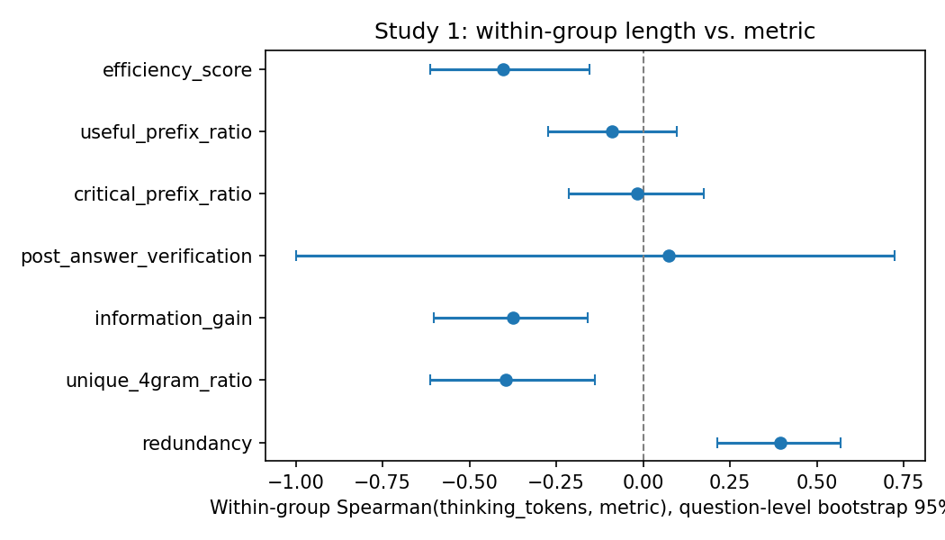
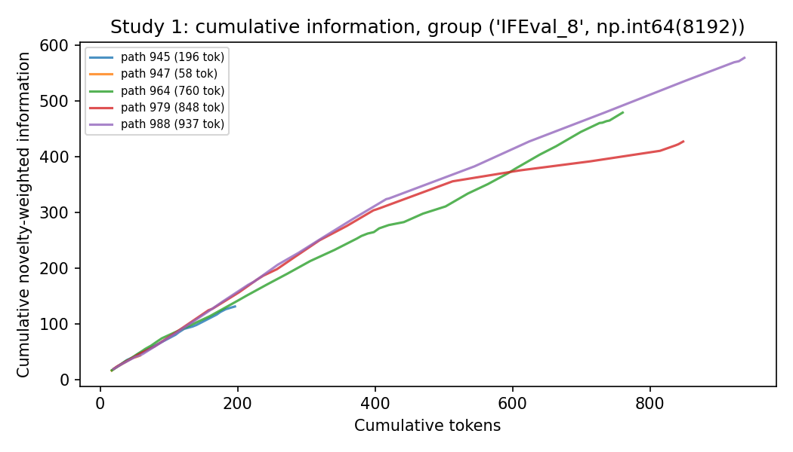
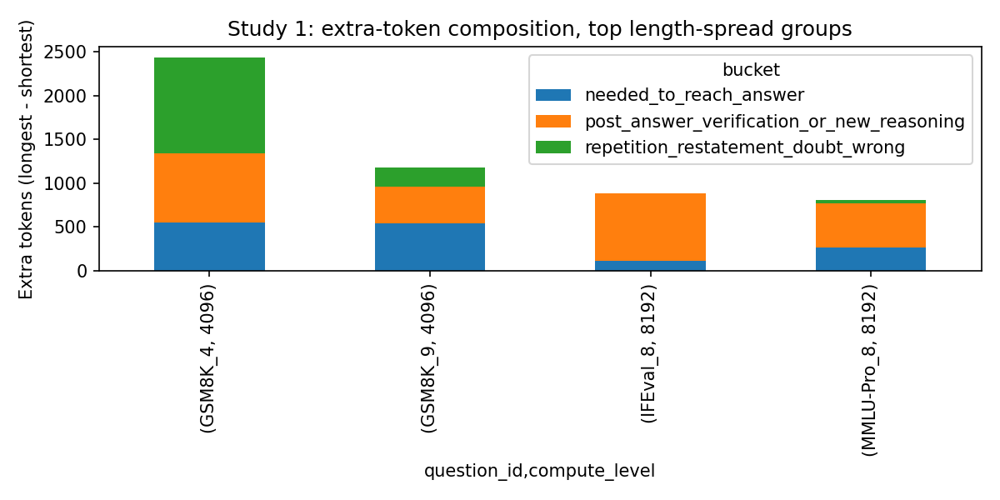
Orange
Innovation
H1 — TEST FINDINGS
Analysis A — Over samples · Efficiency & attribution (Study 1)
Setup: per (question, compute_level) group of 5 samples, stratified by outcome mix
(Study 1: all-correct & high dispersion, n=130 paths).
Efficiency (Study 1): longer correct paths are compositionally less efficient — more token-weighted redundancy (+0.40 Spearman), less lexical diversity (–0.40), less information gain (–0.38), lower efficiency score (–0.40); all survive Holm-corrected 5% testing, large standardized effect ≈ –0.99.
Extra-token attribution: of the tokens that make a correct path longer, ~55% arrive after the answer is committed (verification-style / new-reasoning), ~26% to reach the answer, ~19% overt churn. Post-answer verification rate does not rise with length → extra, largely non-informational effort.
fig1 · length vs metrics
fig3 · cumulative info
fig2 · token attribution
Dynamic Test-Time Compute Allocation
23

Slide 25
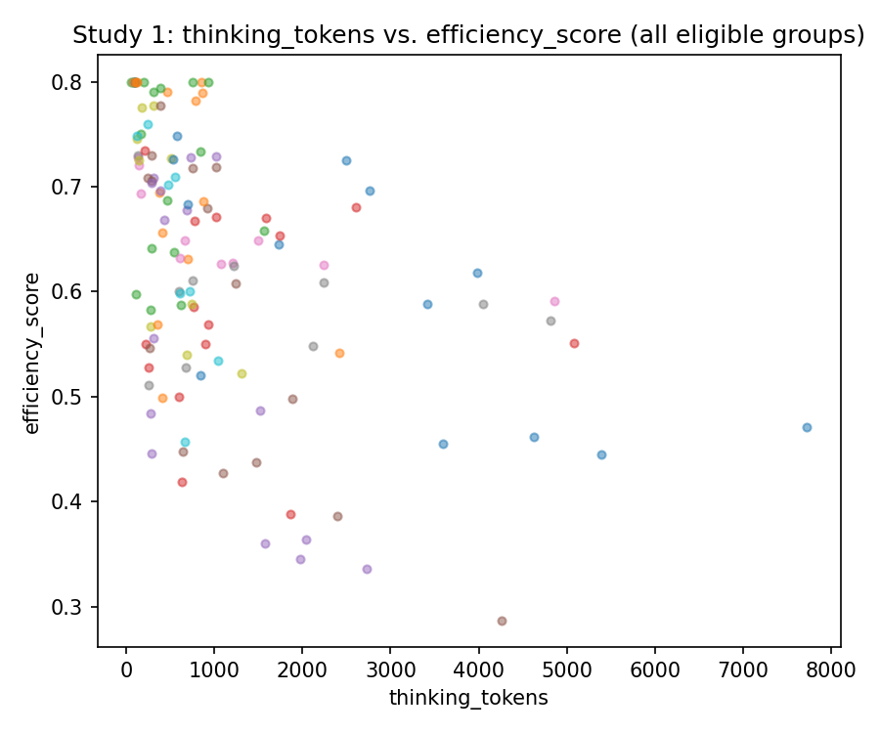
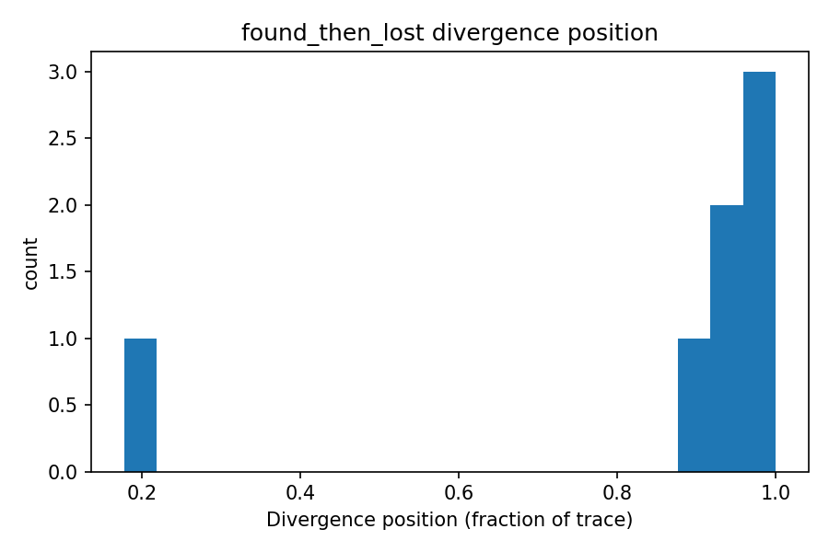
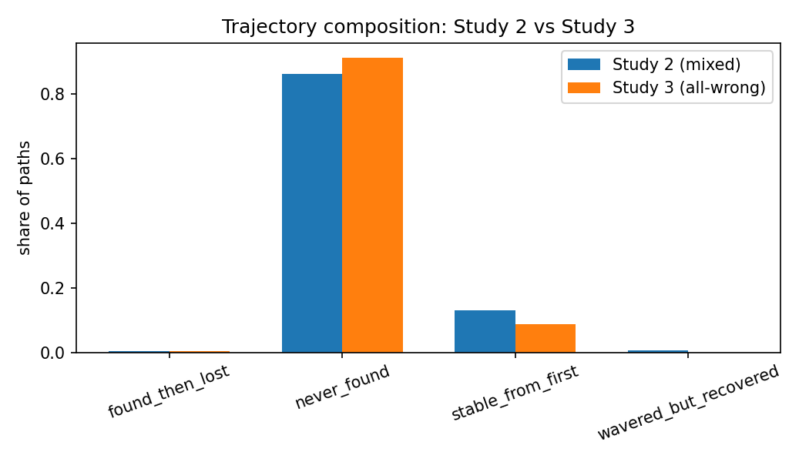
Orange
Innovation
H1 — TEST FINDINGS
Analysis A — Over samples · How failure looks (Studies 2–3)
How failure looks (Studies 2–3): mixed groups: incorrect paths differ mainly by fewer explicit answer flips (p = 0.010) — they settle early on a wrong answer and stick (not thrash); incorrect paths slightly longer (mean thinking tokens 1,767 vs 1,579). All-wrong groups: never_found dominates (91.1%).
Tooling validation: trajectory classifier 4/4 PASS on synthetic traces;
efficiency score 9 PASS / 2 FAIL
(c_info dominance 0.956, ρ = –0.54 vs length → associational only).
fig4 · within-group
fig5 · divergence pos
fig7 · trajectory comp
Dynamic Test-Time Compute Allocation
24

Slide 26
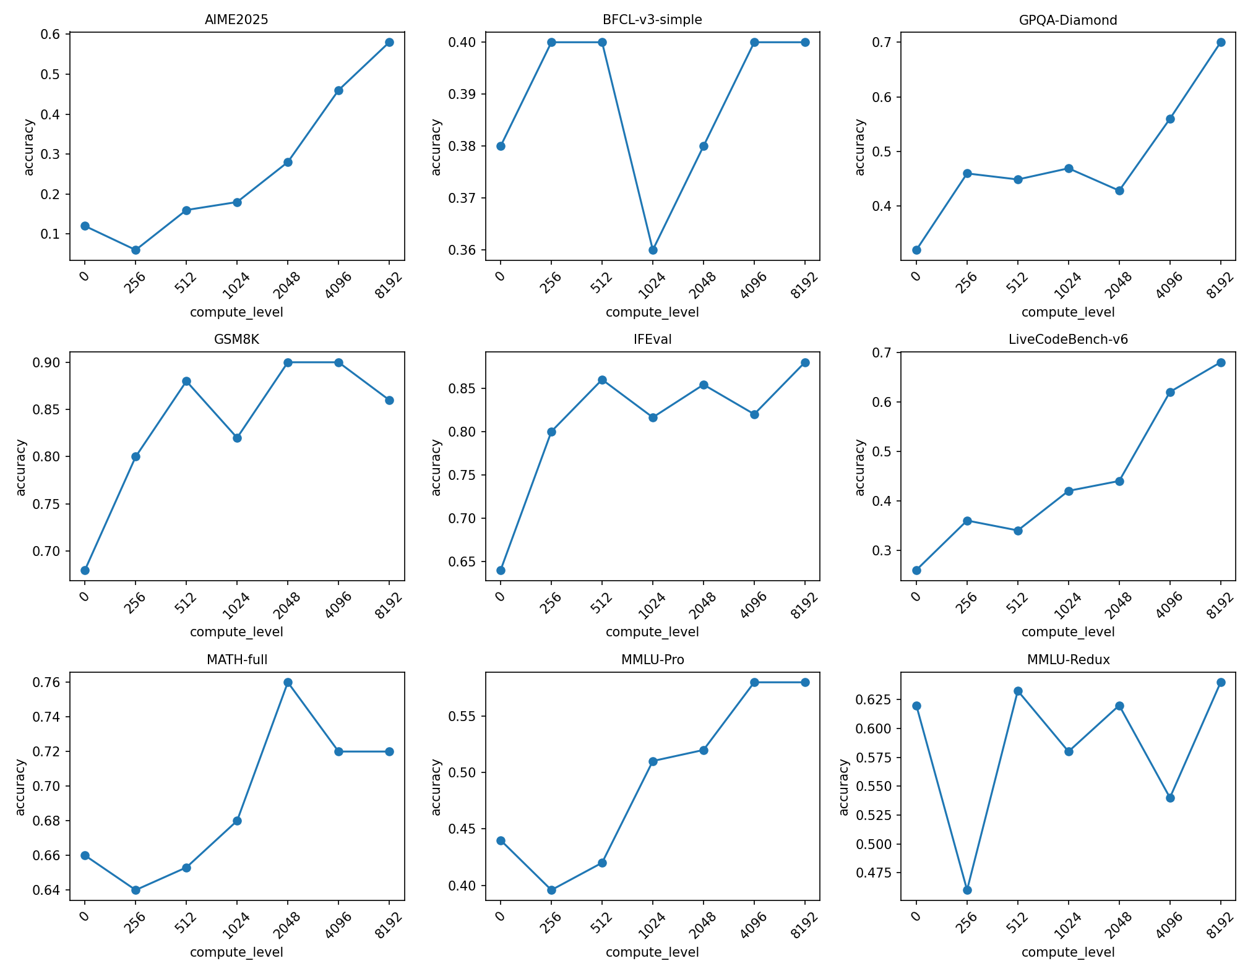
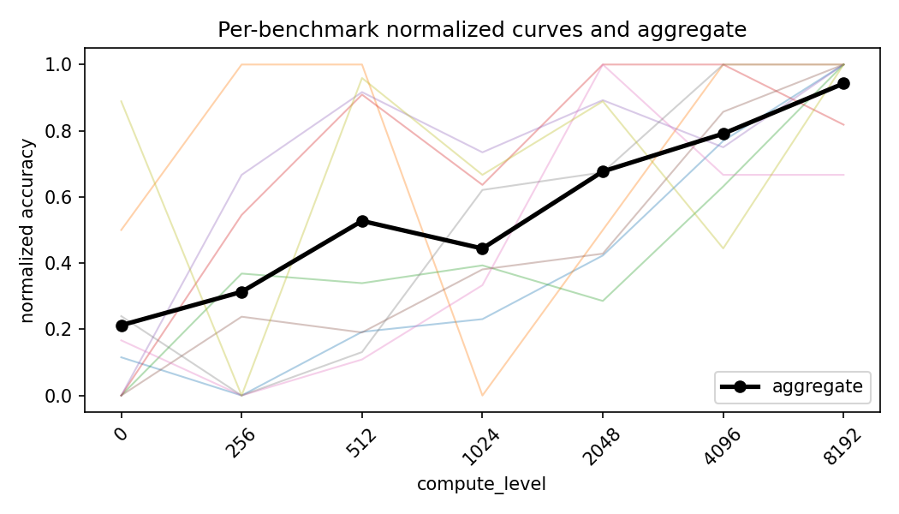
Orange
Innovation
H1 — TEST FINDINGS
Analysis B — Over benchmarks
Per benchmark, accuracy at every compute level →
Kneedle elbow = compute level past which more compute yields diminishing returns.
Benchmark
Kneedle optimal compute level
AIME2025
256
BFCL-v3-simple
256
GPQA-Diamond
256
fig8 · raw accuracy curves
GSM8K
512
IFEval
512
LiveCodeBench-v6
256
MATH-full
None (no interior knee — flat/noisy)
MMLU-Pro
512
MMLU-Redux
4096 (non-monotone curve, opposite loading)
Most benchmarks elbow at 256–512 thinking tokens.
AIME2025 gains the most in absolute terms.
fig10 · normalized curves
Dynamic Test-Time Compute Allocation
25

Slide 27
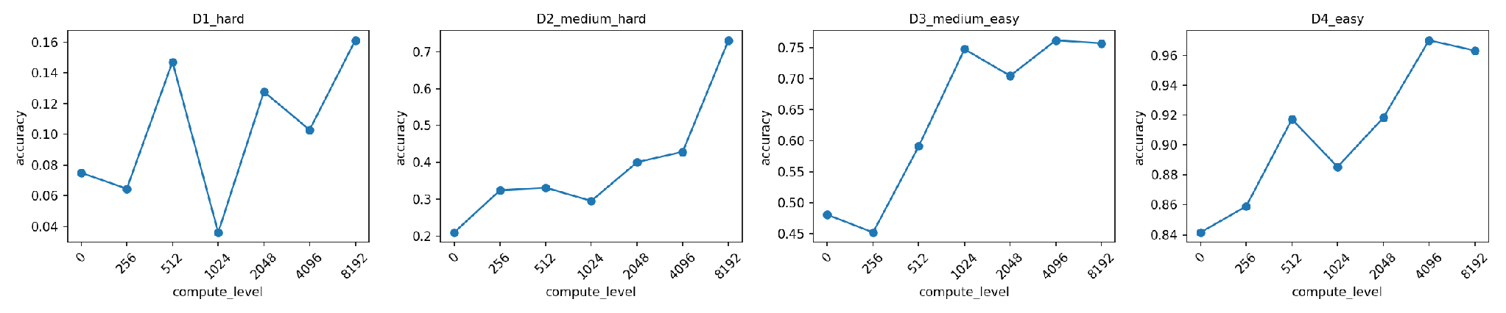
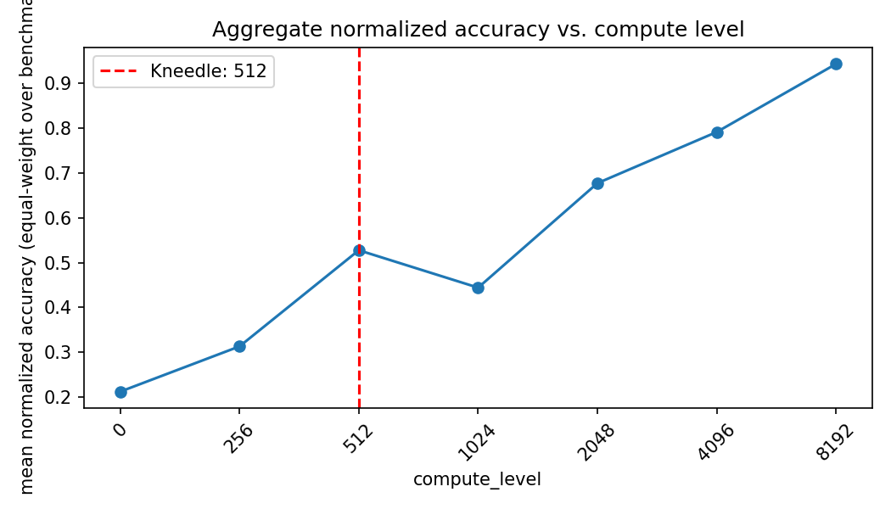
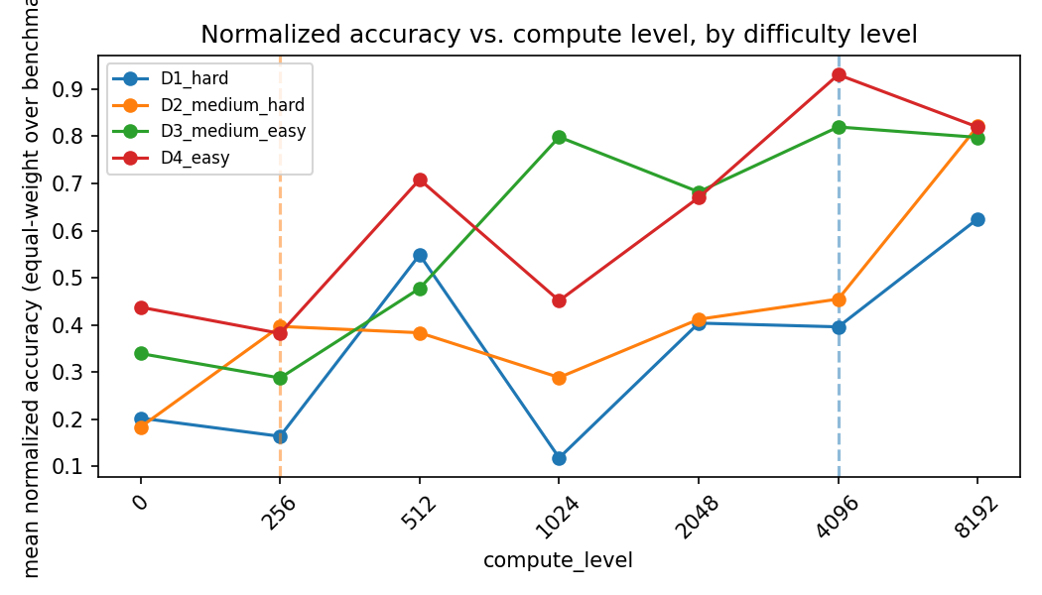
Orange
Innovation
H1 — TEST FINDINGS
Analysis C & D — Compute level & difficulty
Over compute level (size-robust aggregate): each benchmark’s curve min-max normalized then averaged with equal weight (no benchmark excluded). Kneedle aggregate knee = 512. Normalized accuracy: 0.21 → 0.53 by 512 → 0.94 at 8192; inter-benchmark spread shrinks 0.40 → 0.12. 512 tokens is where aggregate compute gains begin to plateau.
Over difficulty (derived, fixed pass-rate bands): D1 hardest ([0,25%) pass, 26 q): knee 4096, accuracy still only 0.075 → 0.161. D2 medium-hard ([25,50%), 13 q): knee 256. D3 medium-easy ([50,75%), 15 q): no knee (erratic). D4 easy ([75,100%], 36 q): knee 512 (raw); none normalized (ceiling).
Headline for H1: the aggregate knee (512) is far below the max budget (8192) → most gain comes cheaply; hard questions still want far more; overthinking appears as saturation, not a global inverted-U (no benchmark shows a true accuracy drop at high budgets).
fig11 · difficulty accuracy curves
fig9 · compute-level aggregate
fig12 · difficulty normalized
Dynamic Test-Time Compute Allocation
26

Slide 28
Orange
Innovation
H1 — TEST FINDINGS
Key takeaways & verdict
Verdict on H1 (as executed on LFM2.5-2.6B): poor allocation harms performance mainly as underthinking vs wasted compute: global knee at 512 tokens; easy/medium saturate early (256–512) while the hardest band keeps improving up to 4096 (still ~16% accuracy). No clean inverted-U → overthinking manifests as saturation (flat accuracy, wasted tokens) rather than net accuracy loss here.
Quality side: longer correct paths add ~55% post-answer, mostly non-informational tokens; failing paths settle early on a wrong answer (fewer flips, p = 0.010) and almost never find the correct answer (91.1% never_found) — consistent with insufficient compute / poor convergence signal, not thrashing.
Consequence for the pipeline: supports the difficulty-gated budget (C₀ = A·d̂^β + C_min) plus a reactive convergence signal; conformal calibration fits the “stop when confident / pre-emptively stop likely-unsolvable” structure.
Limitations box: single model family (cross-model H2 not yet run on this data); lenient graders (IFEval ~8 checkers, BFCL syntactic, LiveCodeBench public-tests-only) bias the level not the shape; difficulty derived → selection effect; findings associational, not causal.
Dynamic Test-Time Compute Allocation
27

Slide 29
Thanks

